Slide 1

DDoS Attack Detection model
A Distributed Denial of Service (DDoS) attack uses many computers to launch a coordinated DoS attack against one or more targets.
Group No. 38
Sanket Kulkarni (A20537896)
Ameya Hujare (A20545367)
Deep Pawar (A20545137)
Prof: Yan Yan

Slide 2

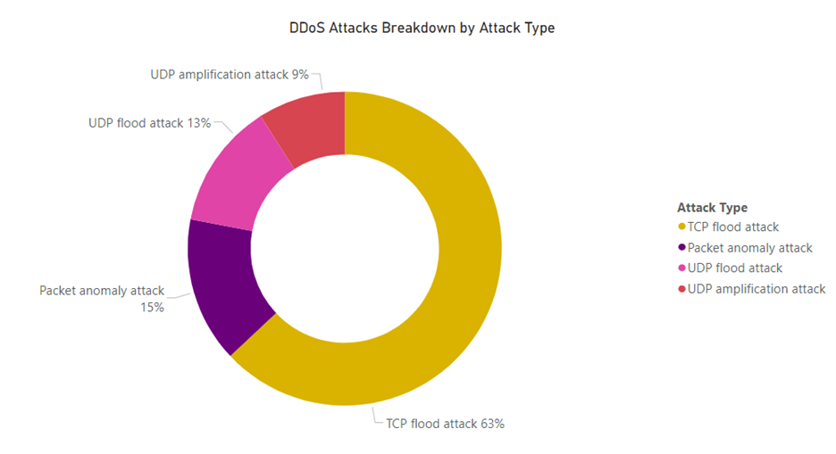
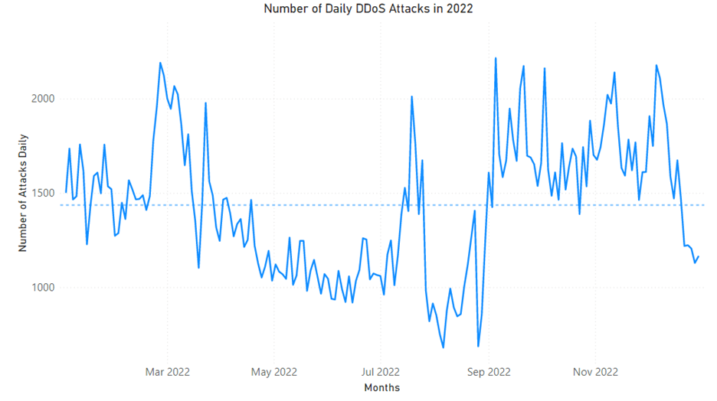
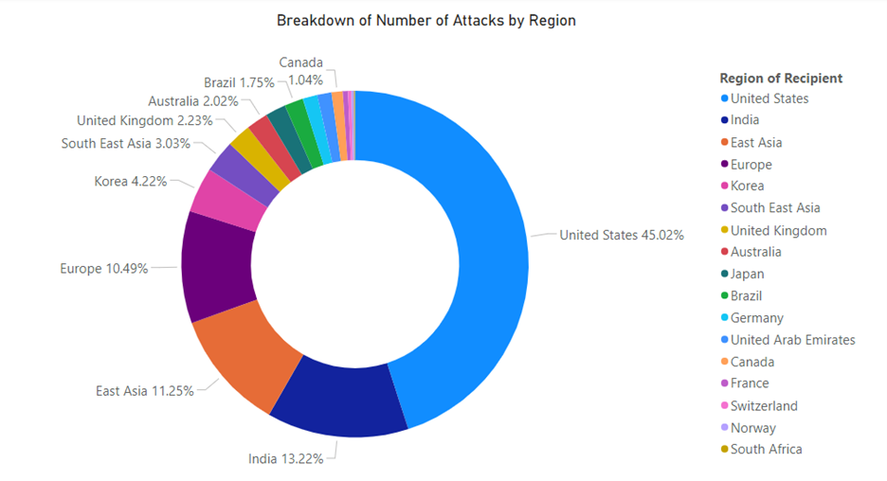
WHY DDOS ATTACK AWARENESS IS IMPORTANT?

Slide 3
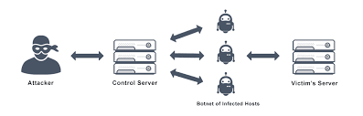
ABSTRACT
A distributed denial-of-service (DDoS) attack targets websites and servers by disrupting network services. A DDoS attack attempts to exhaust an application’s resources. The perpetrators behind these attacks flood a site with errant traffic, resulting in poor website functionality or knocking it offline altogether. Virtualization is used to stimulate a live DDoS and dos attack. This attack is then captured by Wireshark . This live data is then put through CIC flowmeter which gives us the desired attributes . To mitigate the DDoS attack, the machine learning algorithm can be used. We propose a machine learning technique namely Decision Tree(Random Forest) a to detect malicious traffic. This will provide better accuracy and detection rate. We use CICIDS 2017 dataset which compare the datasets by taking realistic network configuration.

Slide 4

PROBLEM STATEMENT
DDoS attacks pose a significant threat to organizations by inundating servers with malicious traffic, causing service unavailability and financial losses.
Traditional detection methods often fail to identify sophisticated DDoS attacks. Our model uses a Machine learning approach to address this challenge.

Slide 5

ALGORITHM USED IN MODEL

Slide 6
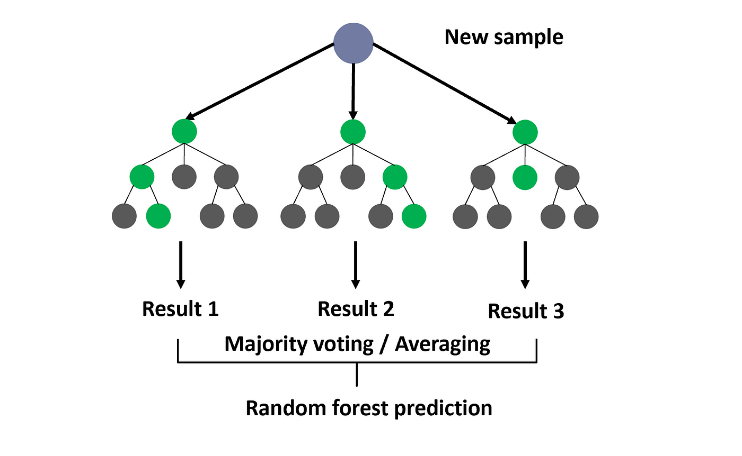
RANDOM FOREST CLASSIFIER
Supervised learning algorithm which is used for both classification as well as regression.
Creates decision trees on data samples and then gets the prediction from each of them and finally selects the best solution by means of voting.
Introduces randomness by selecting random subsets of features and samples for each tree.

Slide 7
CONCEPTS USED IN MODEL

Slide 8



VIRTUALIZATION
Virtualization is a process that allows for more efficient utilization of physical computer hardware. Virtualization uses software to create an abstraction layer over computer hardware that allows the hardware elements of a single computer—processors, memory, storage.
We simulated different types of malicious attacks by using virtualization. This gave us a safe environment which isolated the host OS and real world network connection.
Two types of virtual OS were used:
Kali linux (Attacker machine)
Ubuntu (Victim machine)

Slide 9

HPING3
hping3 is a network tool able to send custom ICMP/UDP/TCP/NTP packets and to display target replies like ping does with ICMP replies.
We can test firewall rules, perform (spoofed) port scanning, test network performance using different protocols.
It supports TCP, UDP, ICMP and RAW-IP protocols, has a traceroute mode, the ability to send files between a covered channel, and many other features.

Slide 10


WIRESHARK
Wireshark is a network protocol analyzer, or an application that captures packets from a network connection, such as from your computer to your home office or the internet. Packet is the name given to a discrete unit of data in a typical Ethernet network.

Slide 11

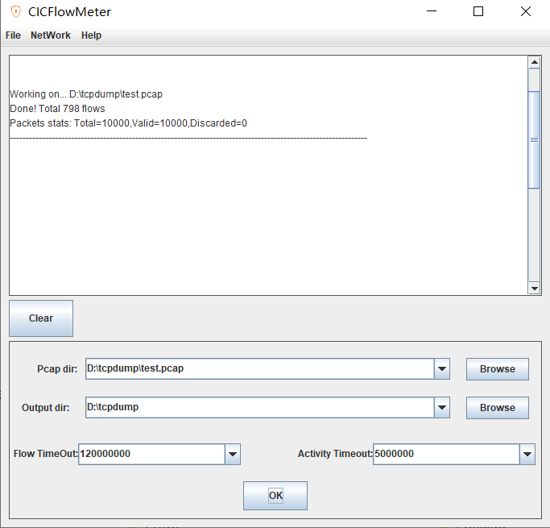
CIC FLOWMETER
The CIC FlowMeter is an open source tool that generates Biflows from pcap files, and extracts features from these flows.
It can be used to generate bidirectional flows, where the first packet determines the forward (source to destination) and backward (destination to source) directions.

Slide 12
DEMO OF THE MODEL

Slide 13

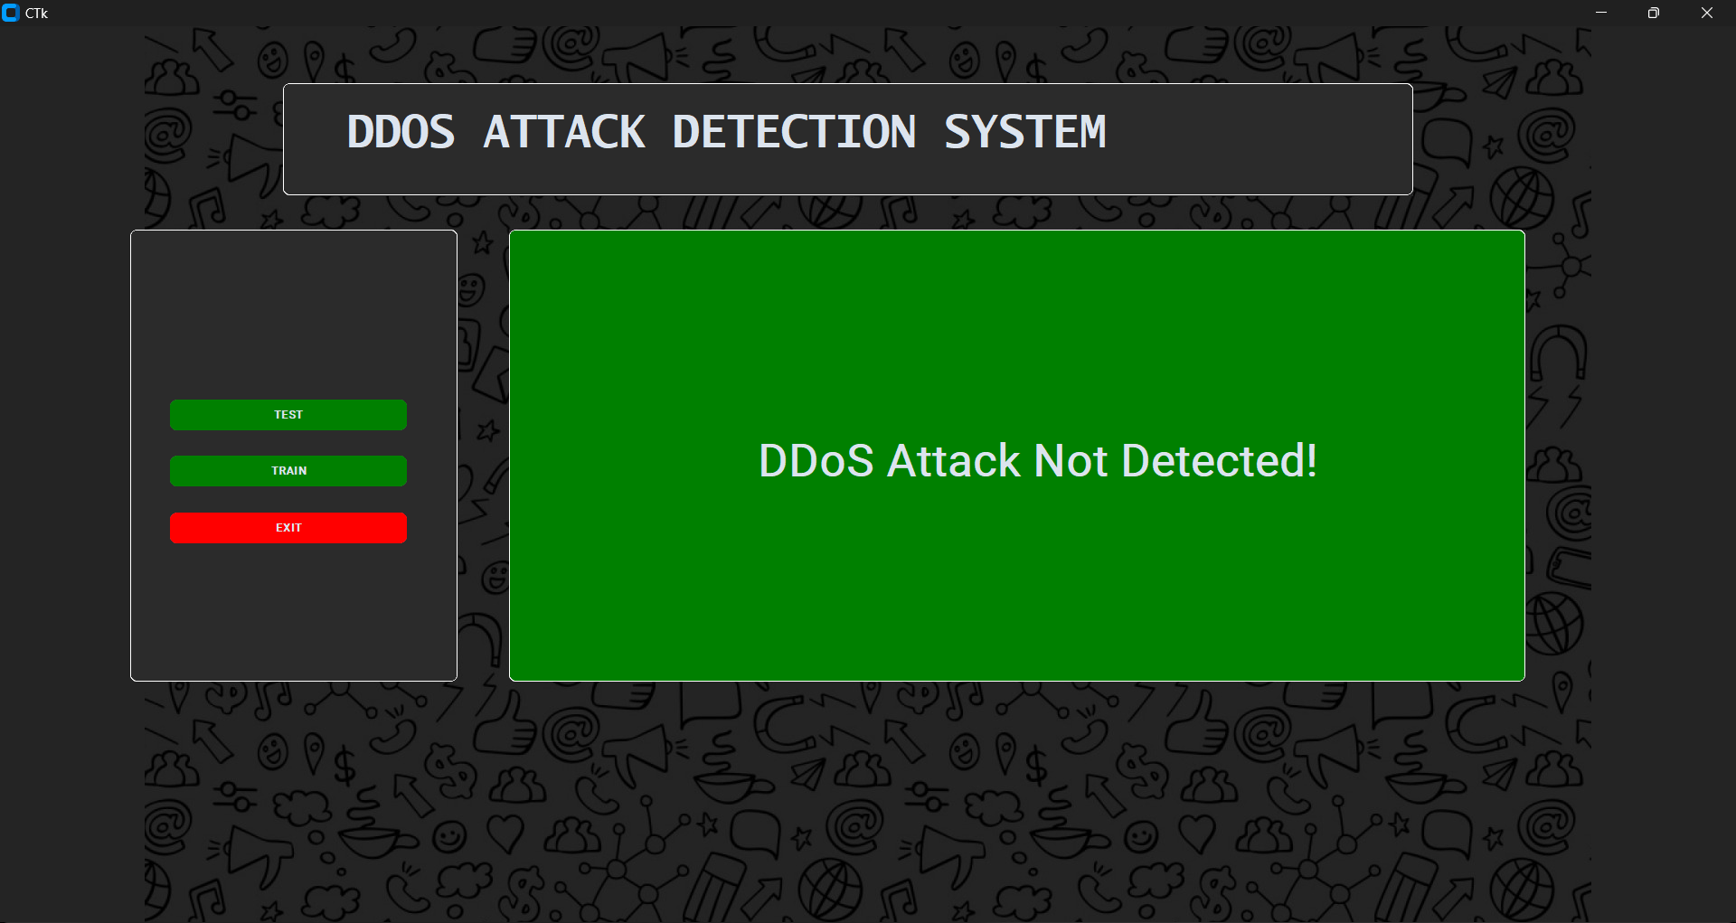
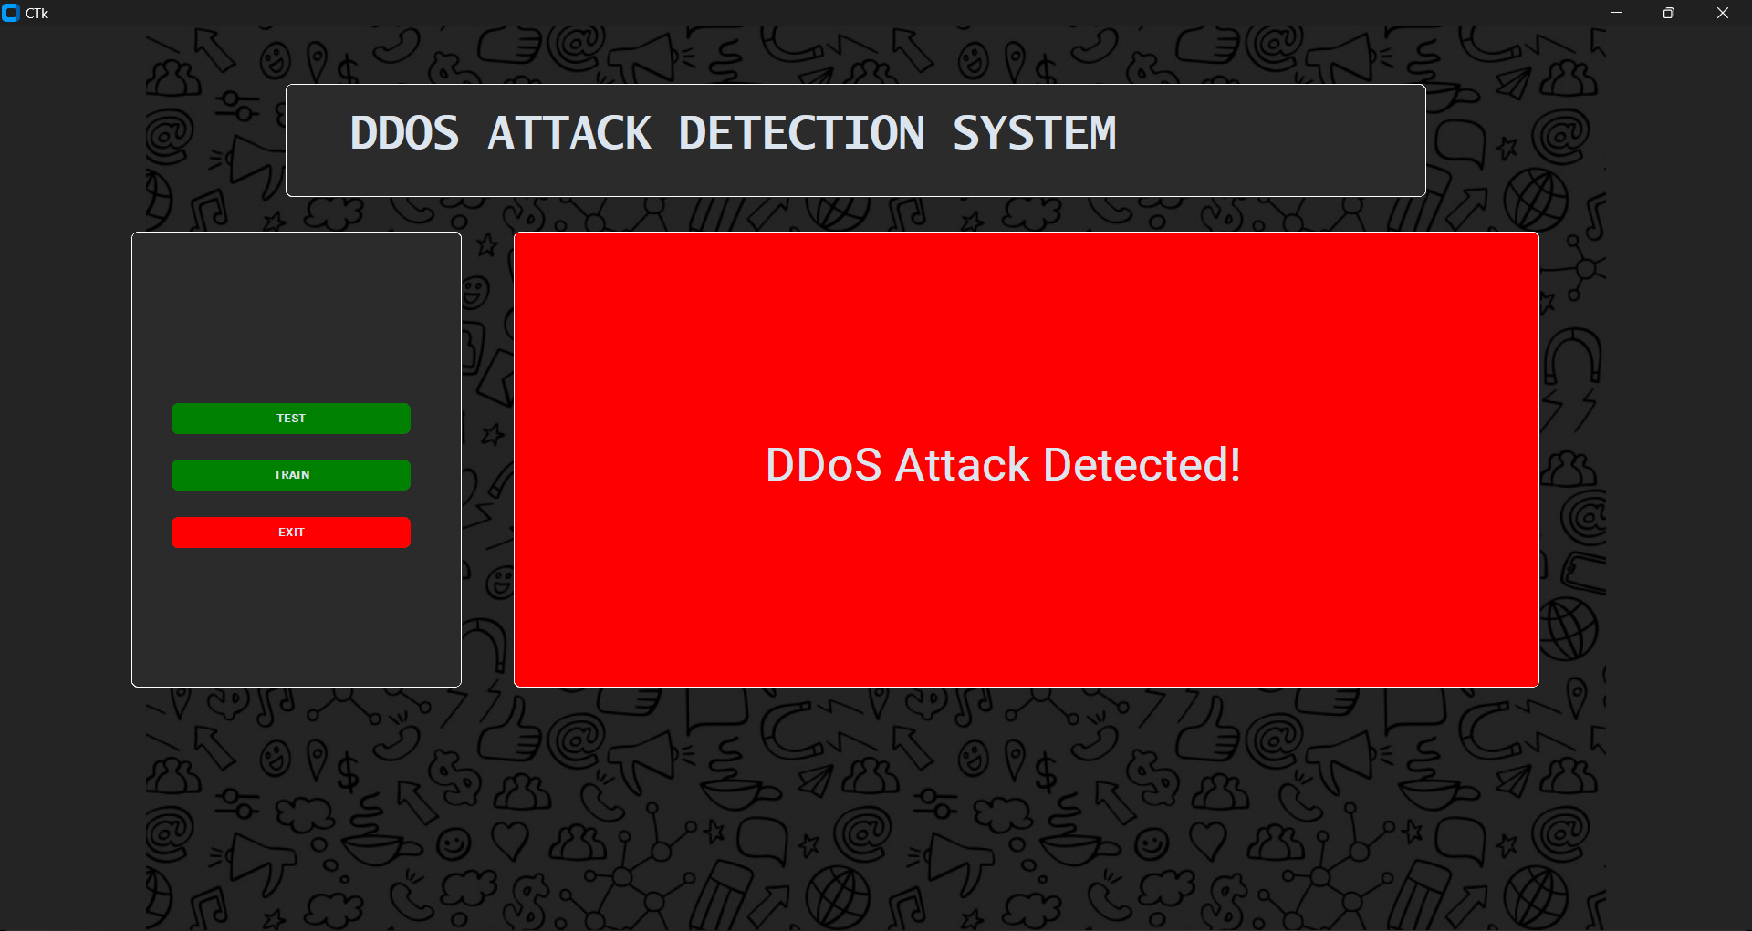
Results

Slide 14
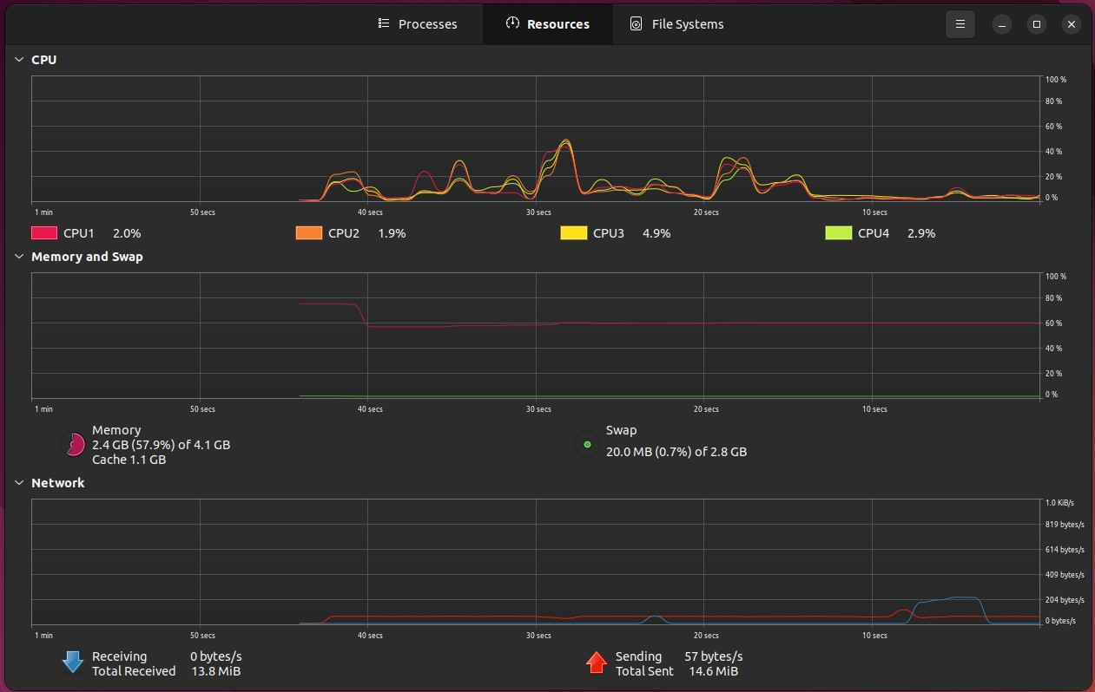
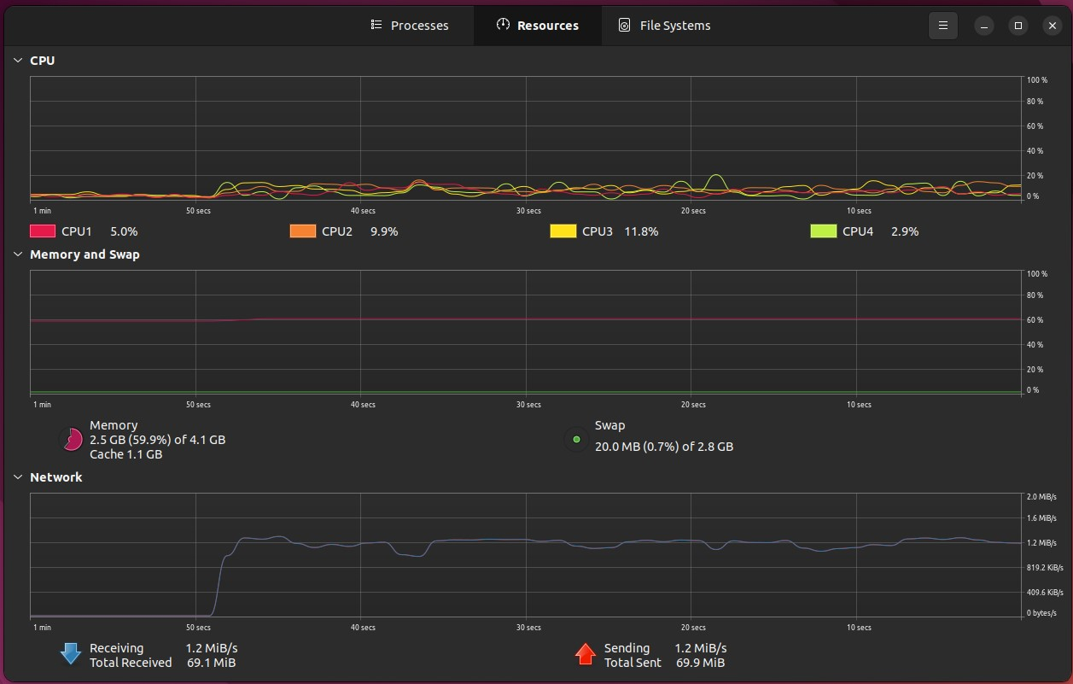
Results
Before
After

Slide 15
QUESTIONS?

